Slide 1

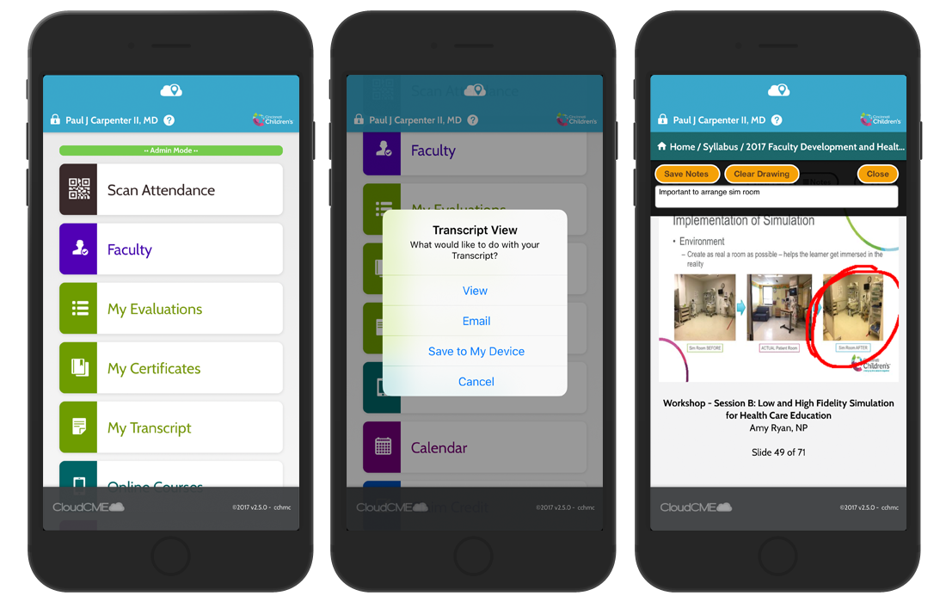
Activity Sign in Process
Via CloudCME® Mobile App
Step 1: Download the CloudCME mobile app (If you have not already done so)
Step 2: Open the App, use Organization code:
Step 3: Click the Login or Create Account button
Step 4: Select the login option that applies to you
*LVHN-Jefferson employees should use their Jefferson email address and password to log in
*Non-Jefferson users should select “All Others”

Slide 2
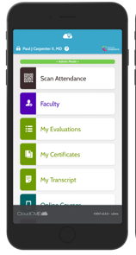
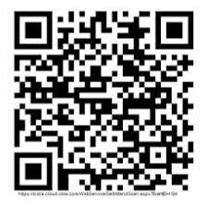
Activity Sign in Process
QR Code Scanning
Scan the QR code using the ‘Scan Attendance’ button in the CloudCME® mobile app.
*Do not use your mobile camera to scan the code
Insert QR CODE here
(Sample QR Code)

Slide 3
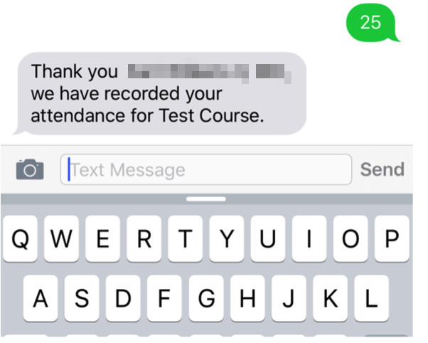
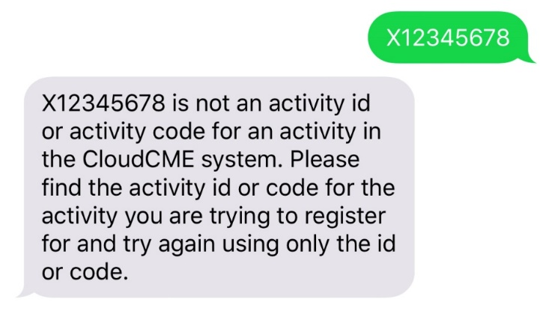
Activity Sign in Process
SMS Texting Instructions
These instructions are intended only for users that have an active account in CloudCME®. Attendance can only be recorded {60 minutes prior to the meeting, during the activity, or within 2 days after the meeting}.
Step 1: Pair your mobile device to your account in CloudCME®. (ONE TIME ONLY) Organization code:
Text the email address associated with your account to (888) 352-5547. You MUST use your SSO email if you have one. A message will be sent that looks like the one below.
Step 2: Text the SMS CODE provided, to (888) 352-5547. *Tip: Add the 10-digit number as a contact.
SMS CODE
TEXT ACTIVITY CODE
#####
Child ID will be unique for each activity and only work once. If a user attempts to use an activity code that does not exist, they will receive the following message.

